Slide 1


The Road to Spotify Wrapped 2023
Project 1

Slide 2

Spotify Wrapped
Every year Spotify release their data analysis regarding the most played, highest trending songs for the year

Slide 3


Our Clients
Our Clients – Penny Panda and Percy Python want to be in the Top 10 of Spotify Wrapped 2023 but have no idea how to get there!!

Slide 4
Spotify API
Data was collected from Spotify API. The focus of this was Top Tracks for 2012 – 2022. The playlists contain the following information:
a) Artist,
b) Album
c) Track_name
d) Track_id
e) Danceability
f) Energy
g) Key
h) Loudness
i) Mode
j) Speechiness
k) Instrumentalness
l) Liveness
m) Valence
n) Tempo
o) Duration_ms
p) Time_signature
We have then added the additional criteria: popularity, followers of the artists, genres, explicit lyrics and the year/ position the song featured in the list of the top tracks.

Slide 5
Created a Spotify Developer account to get a Client ID and a Secret ID to acess the API
Created a Client which will generate tokens using the Spotify IDs which will allow acess to the API
Created a Client which will extract the information of a specific playlist
Researched the best playlists to provide the information we wanted to analyse
Extracted the relevent play lists data
Extracted additional information relating to each song on the play lists and added to the inital extract
Extracted additional information for each artists on the play lists and added to the play lists data frame
Added a label which showed which year the tracks were from and the poistion there were in each list
Mereged each play list into a final data frame
Code can be found in out repo -https://github.com/hamdamoha/project1_spotify/blob/main/Spotify%20Extraction/Spotify_extraction.ipynb

Slide 6
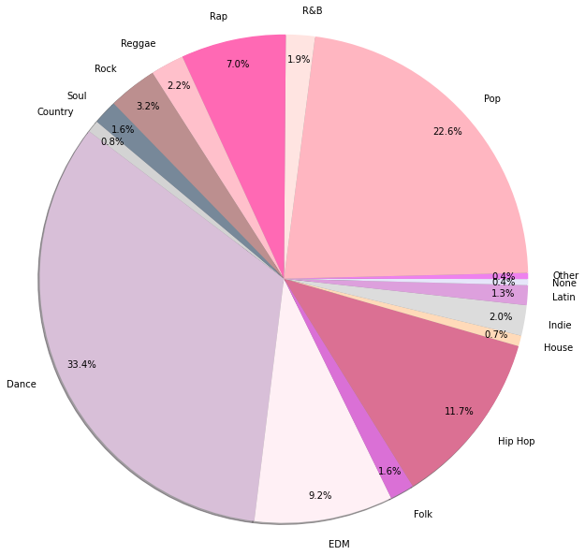
Genre
When looking at the genre over the last 10 years we can see that the most popular categories are
Dance
Electronic Dance Music
Hip Hop
Pop
Rap

Slide 7
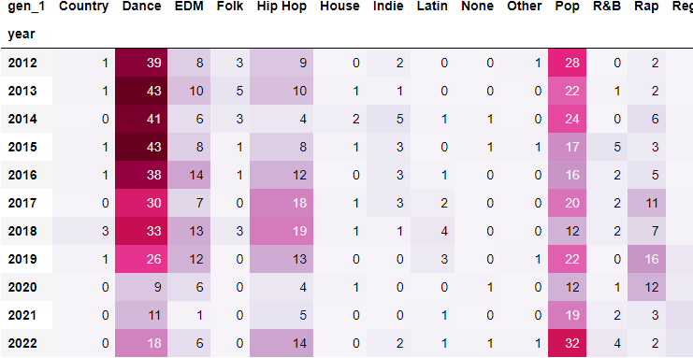
When we start to break this down by year we can see that some of these genres have become less popular over time and some are increasing in popularity

Slide 8
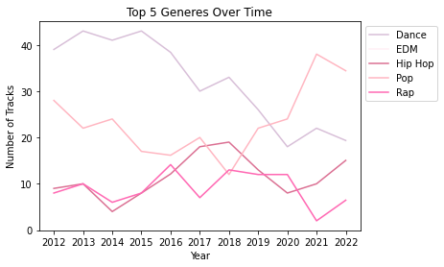
Dance Music has become less prevalent over time, with Hip Hop and Pop increasing their share of the Top Tracks

Slide 9


Our First Recommendation
Pick either a Hip Hop or a Pop Genre for you hit song
Avoid Folk and Country music as they haven’t been represented at all in the Top Tracks for several years!

Slide 10

But What Else make a hit song….
Hypothesis 1: Recent years have a greater energy difference than later years.
Hypothesis 2: Speechiness does not influence the popularity of a song.
Hypothesis 3: There is a direct correlation between “energy” and “danceability” features.
Hypothesis 4: The number of followers an artist has an impact on their position in the top 50 (2022 only)
Hypothesis 5: Tbc (Itai)

